Slide 1
Lesson 6: What causes volcanoes?
Activity 6.1: Volcano Formation
Activity 6.2: Hotspot Formation
Reading 6.2: Is a Hotspot Lurking Beneath the Continental United States?
Notes:
Need Videos

Slide 2
SELF-PACED STUDY!
You will complete an INDIVIDUAL self-paced study for part of Lesson 6. Follow the directions in red carefully!

Slide 3
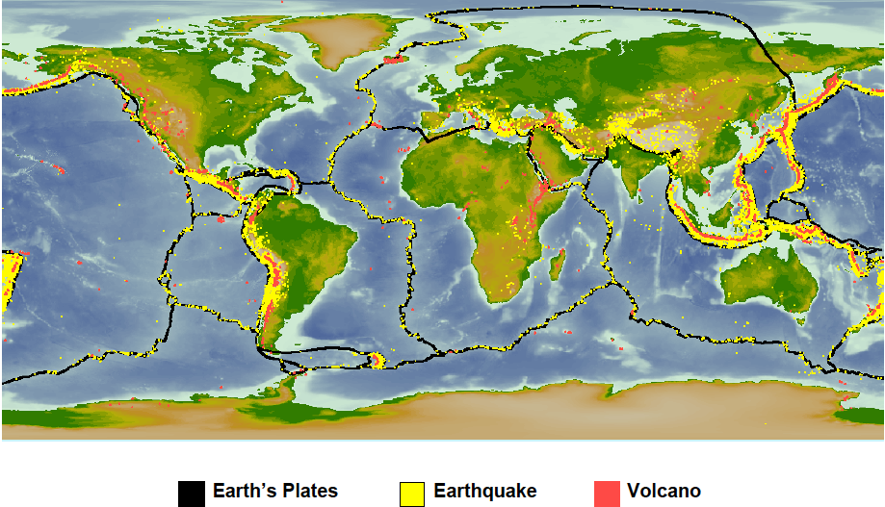
THINK: Where are there volcanoes NOT on a plate boundary? Hint: check out the middle of oceans.
Notes:
TG 82—this is the transition to a different way that volcanoes are formed—hotspots. 1) Point out Himalayan Mt, mid-ocean ridge, Andes Mountains and the Japanese and Aleutian Islands. 2) Hawaii is a good example of volcanoes NOT on a plate boundary.

Slide 4

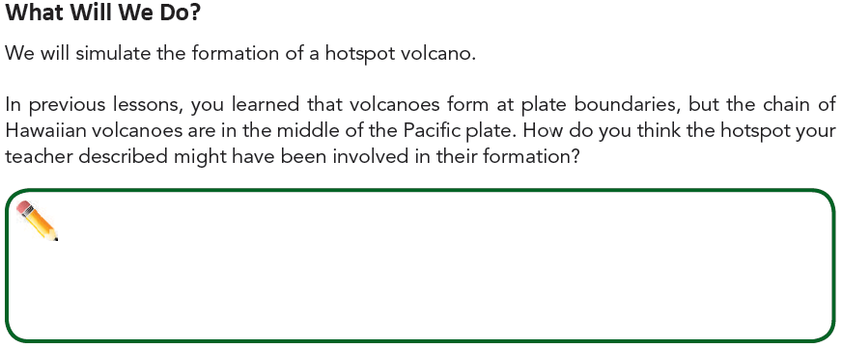
Page 61
ANSWER THE QUESTION ON TOP OF PAGE 61!
Notes:
TG 84-85 SB 49. Point to Hawaii on the DQB.

Slide 5
Watch the following 2 Videos:
Essential Question: How were the Hawaiian Islands formed? Set up the bottom of Page 60 to take Notes. After you’ve watched both videos answer the essential question with several sentences.
Video 1 Notes:
Video 2 Notes:
Video 1 Link Read the text AND watch video: https://www.geolsoc.org.uk/Plate-Tectonics/Chap3-Plate-Margins/Mid-plate/Hawaiian-Islands
Video 2 Link: https://www.youtube.com/watch?v=AhSaE0omw9o

Slide 6
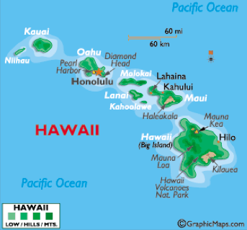
ANSWER # 4 on the bottom of page 61!
Making Sense
4. Look at a map that shows Hawaii, and note the pattern of volcanoes that
make up these islands.
Describe the pattern and
think about how hotspots
cause the pattern.
http://www.worldatlas.com/webimage/countrys/namerica/usstates/hi.htm
Notes:
TG 85 SB 49. Discuss activity and tie to the wax in the beaker activity—spend some time having students design a better simulation of how hotspots cause volcanoes. This question could easily be used as a formative assessment☺.
It is very cool to show them Google satellite images at this point, you can see all sorts of sea mounts.

Slide 7
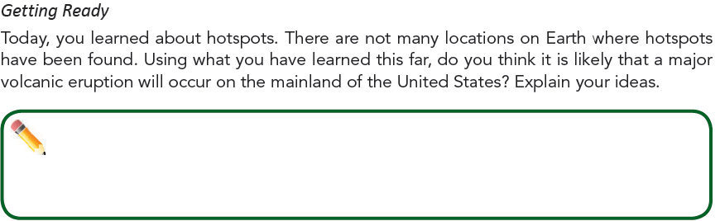
Reading 6.2 Is a hotspot lurking beneath the continental United States? p. 62-63
You will do the reading on pages 62-63. As you read put the letter “E” in the margin for any information that is evidence about whether there is a hotspot in Yellowstone. Answer the questions with complete sentences.
Notes:
TG 86 SB 50-51

